Slide 1
Uxtrata Web Application
Cristian Barragan
https://github.com/CristianBarragan/Uxtrata

Slide 2
Requirements
Create an application, based on C# MVC to manipulate Student and Course database. Use MySQL innodb as the DB engine, relationships between tables are necessary. Use Entity Framework 6 as the ORM framework, and ASP.Net MVC for the UI.
The application shall allow end user to add, edit and delete student and course, and select certain courses for student.
Add cost data field in Course table and build a simple double entry accounting system.
Build a report view page for a statement report of each student’s transaction history. The statement report should base on RDLC format.

Slide 3
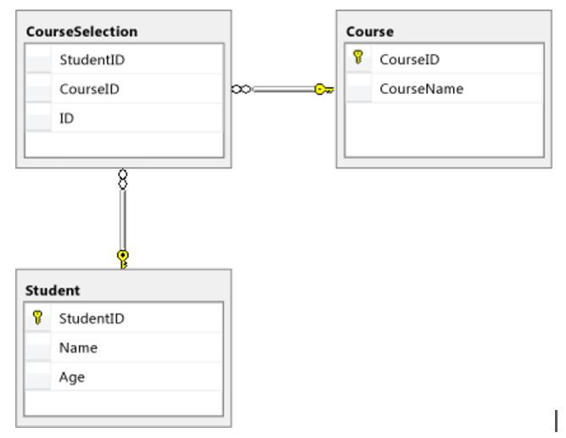
Given Data Model

Slide 4
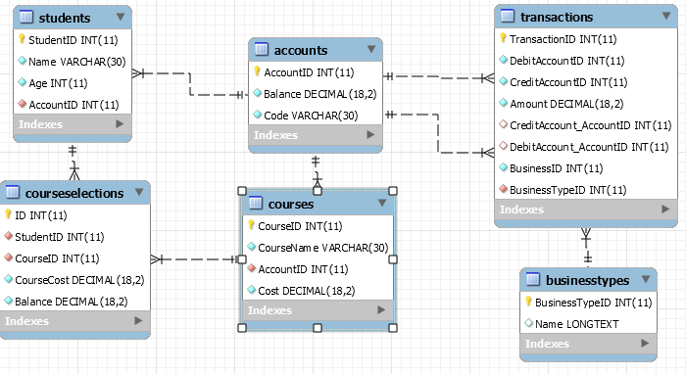
Actual Data Model

Slide 5
Demo

Slide 6
Improvements
Due to the small timeframe to implement the requirements, there are additional improvements to make:
Create Iframe to embed rdlc and sending parameters to filter data using Jquery.
Add Roles and User authentication to pages using Microsoft Identity
Implement Bootstrap to enrich UI.

